Slide 1
Fast end-to-end learning on protein surfaces
Freyr Sverrisson*, Jean Feydy*, Bruno E. Correia, Michael M. Bronstein
Notes:
Hi! In this presentation we'll present to you our paper on fast end-to-end learning on protein surfaces.

Slide 2
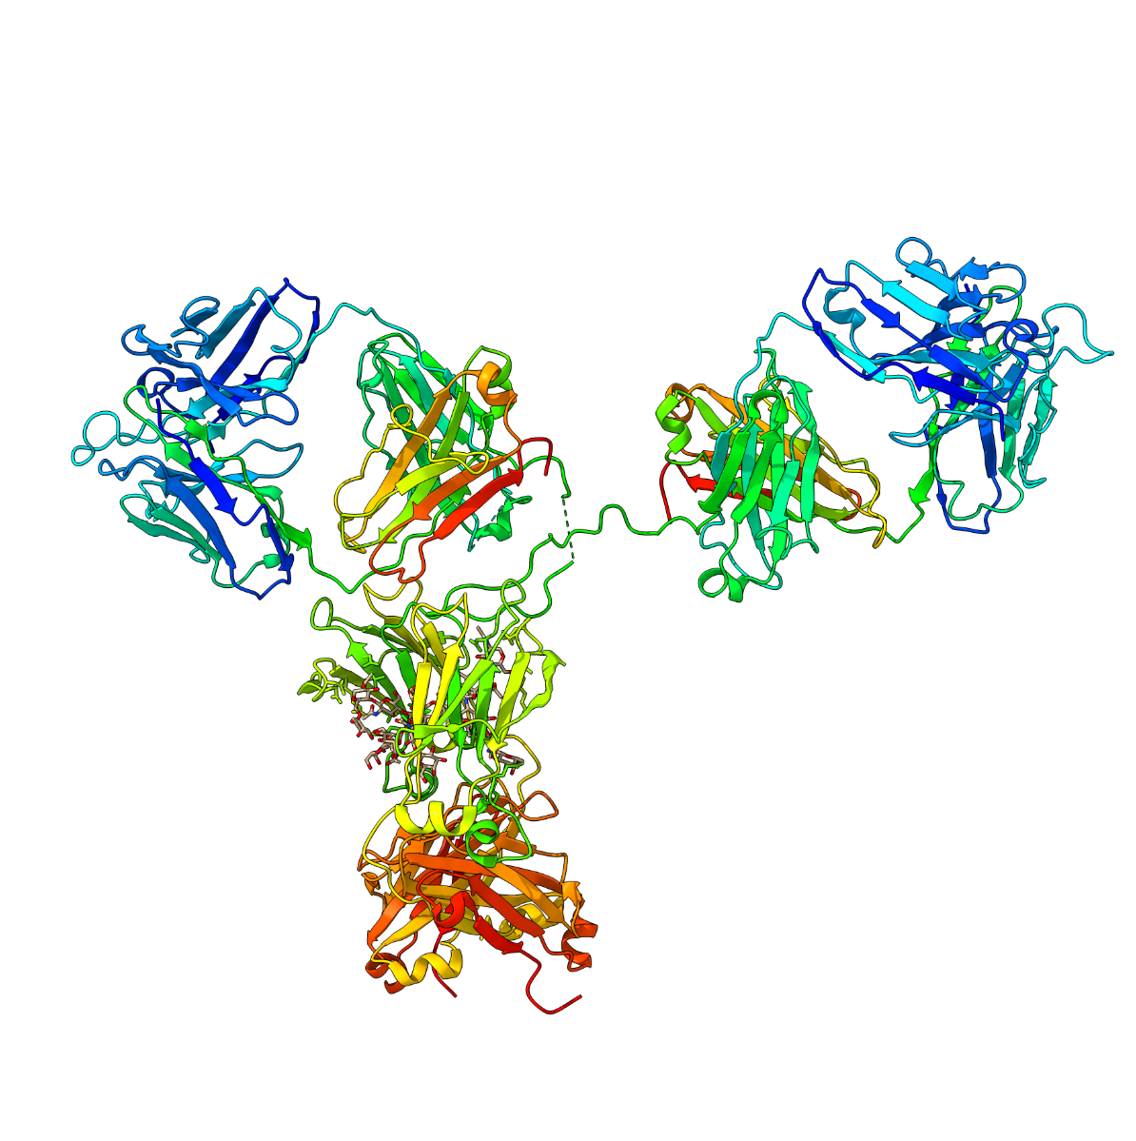
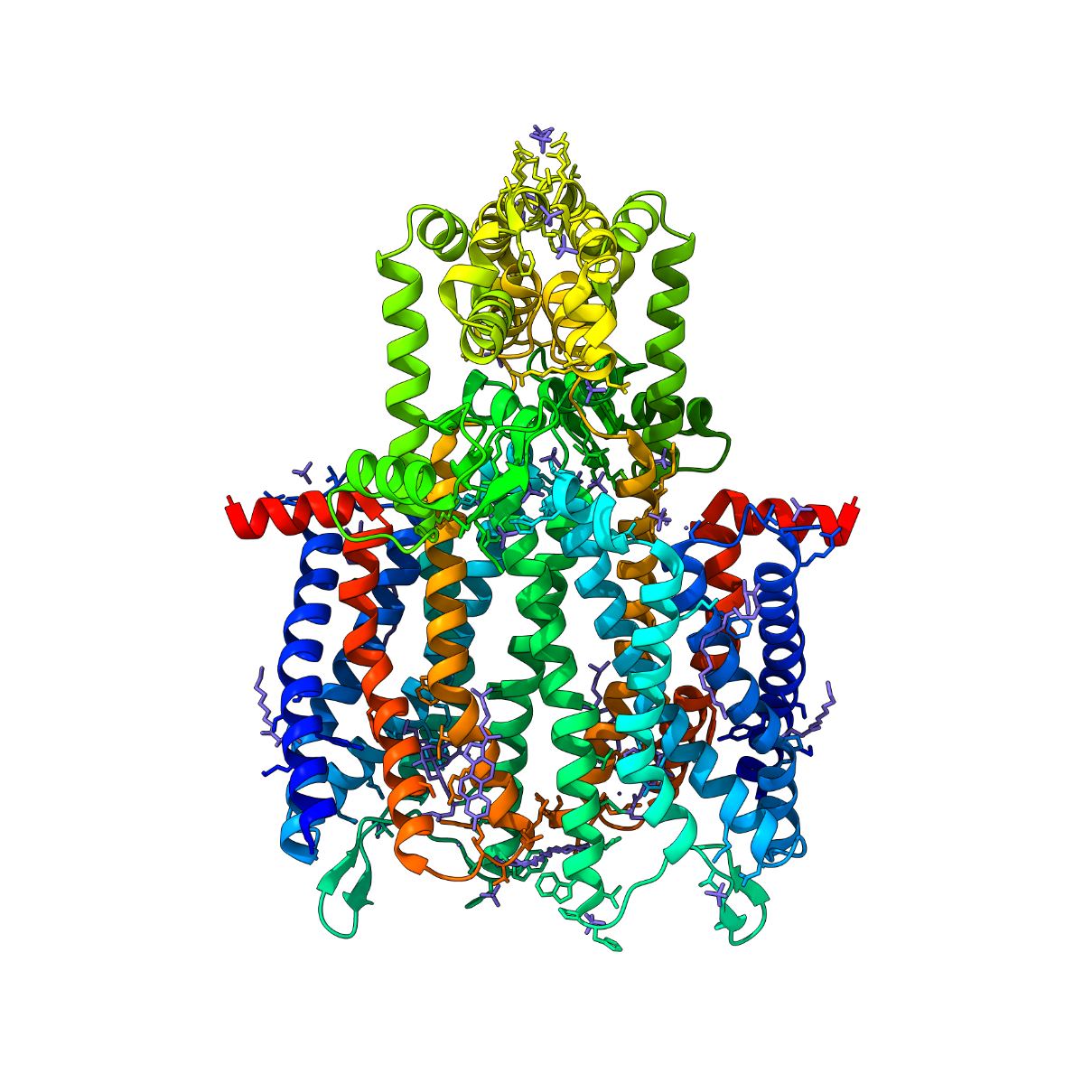
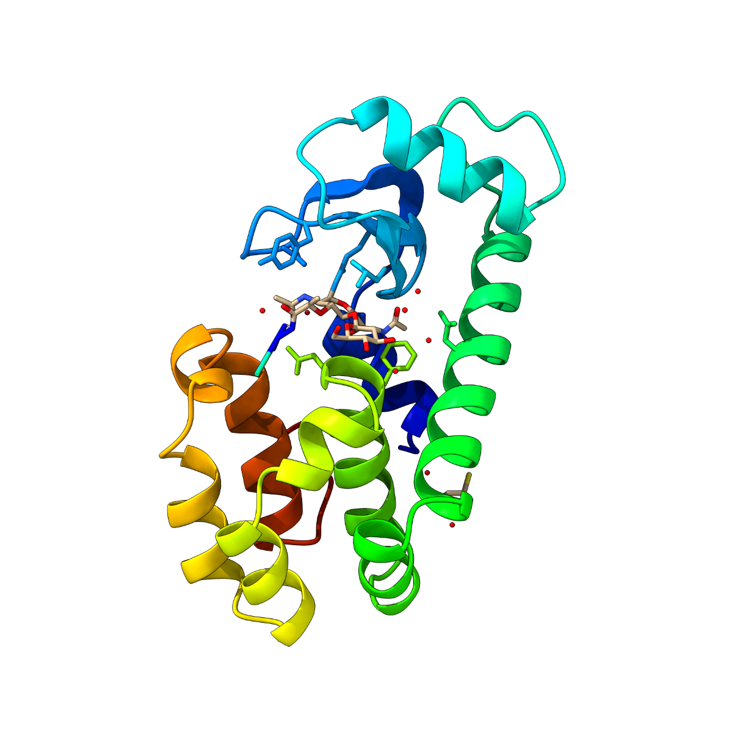
Proteins serve many important roles
Reaction catalysis
Signalling and sensing
Defense against pathogens
Speaker: Freyr Sverrisson
Notes:
Proteins are macromolecules which are essential to all living organisms. They perform most functional tasks within cells such as reaction catalysis, signalling, sensing and defence against pathogens.

Slide 3
Protein structure defines its function
A single amino acid
FUNCTION
Speaker: Freyr Sverrisson
Sequence
Structure
Notes:
Each protein is composed of a sequence of amino acids. This sequence defines the 3D structure of the protein, which in turn defines the functional tasks that the protein can perform.

Slide 4
Problems in protein science
Structure prediction /
Protein Folding
Speaker: Freyr Sverrisson
Sequence
Structure
Notes:
Structural protein science faces several fundamental challenges.
One is the classical problem of protein folding; that is to determine what structure a particular protein sequence is going to take in 3D space.
Over the last few years, this is a question where machine learning methods such as AlphaFold have shown great promise in.
But crucially, knowing this 3D structure only gets you so far.

Slide 5
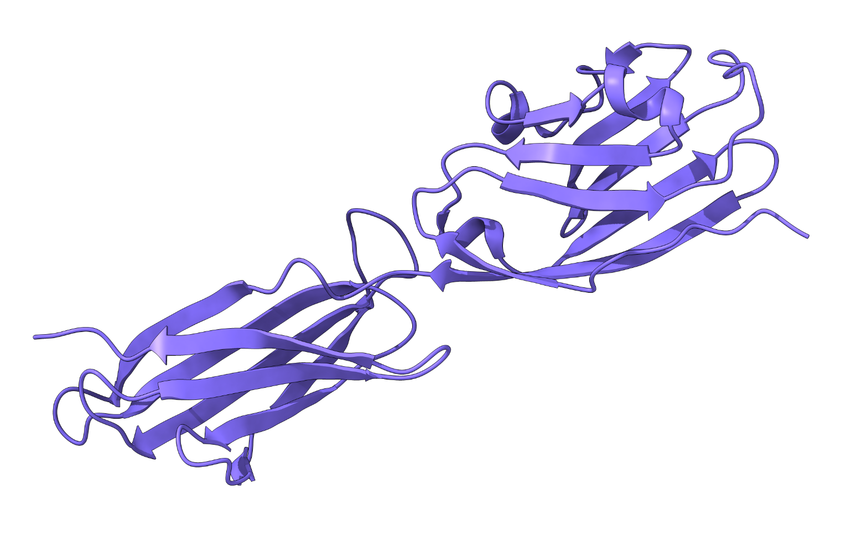
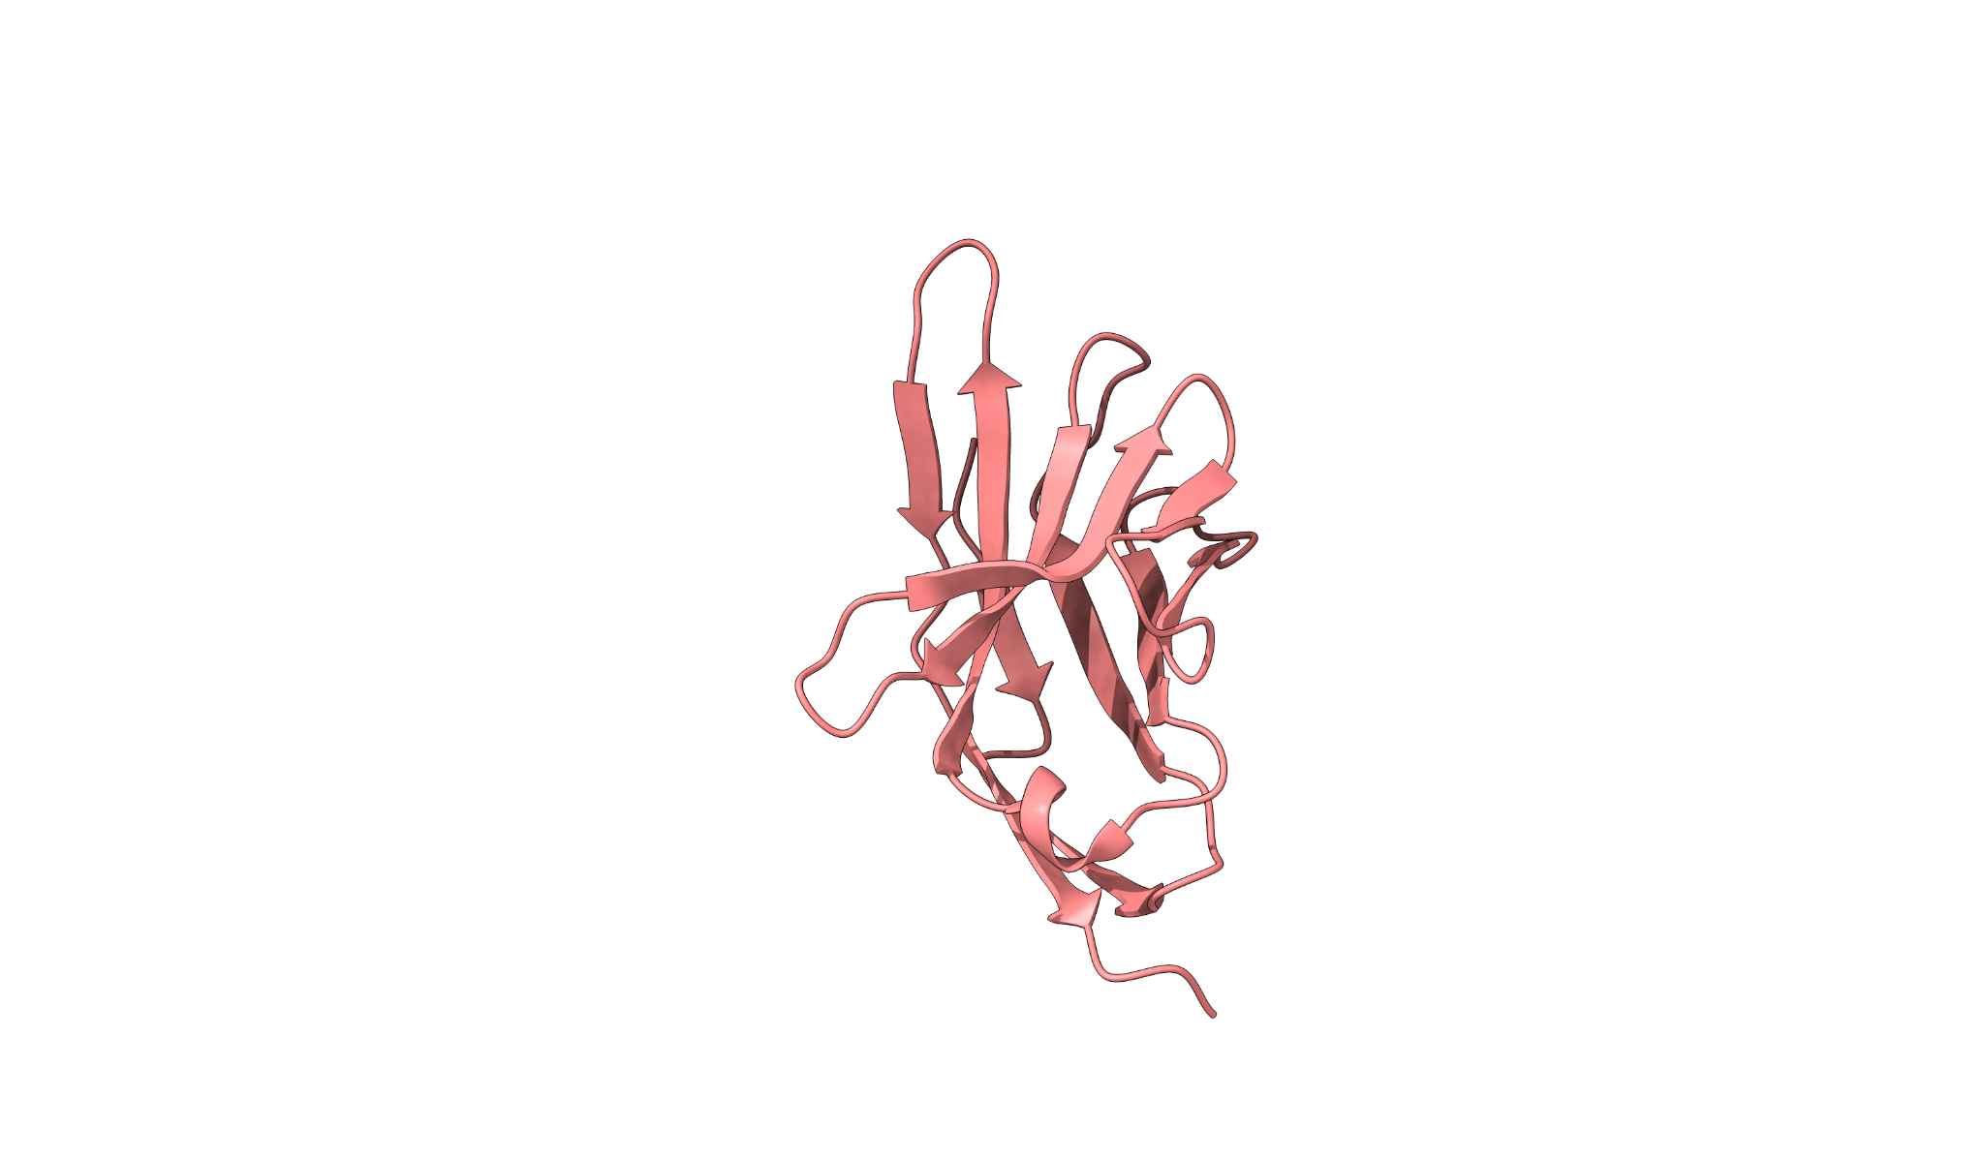
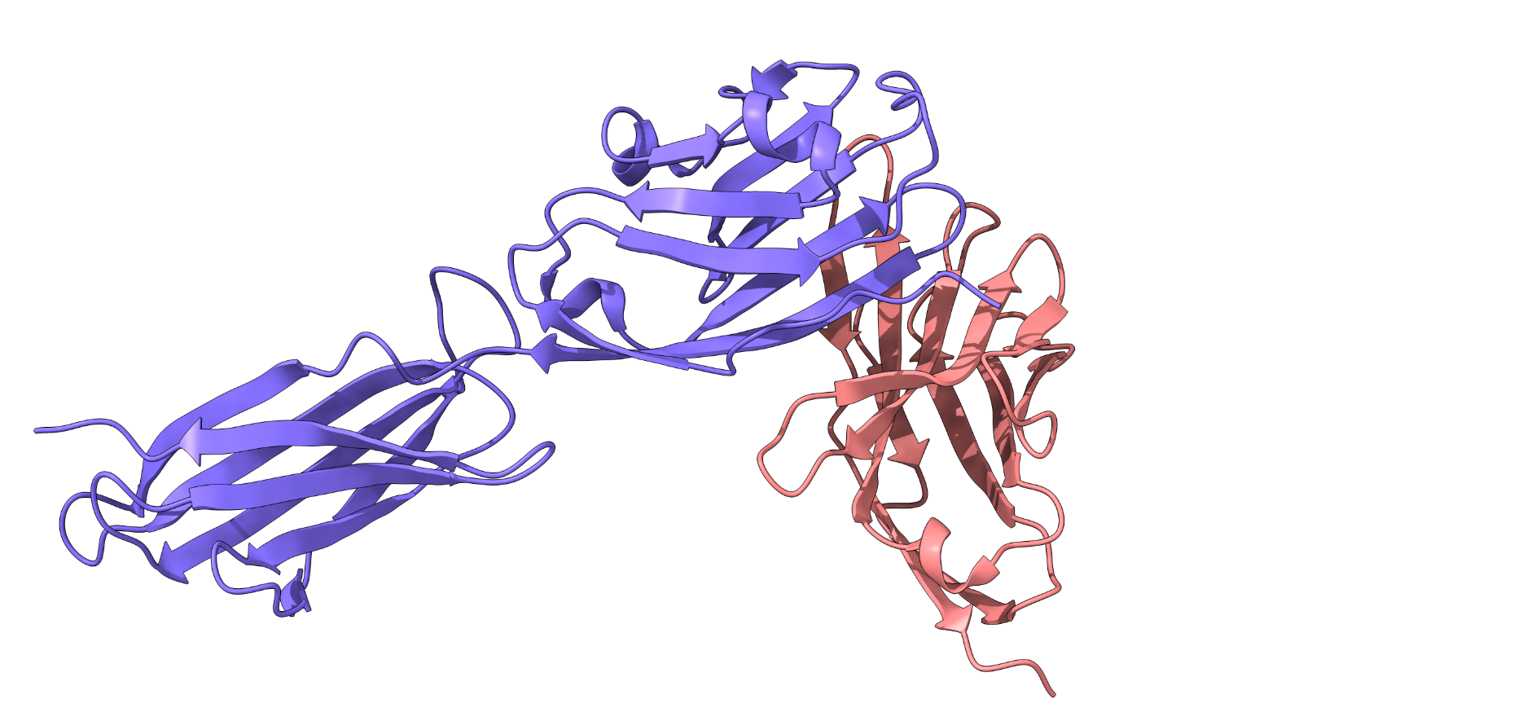
Problems in protein science
Molecular Docking
Speaker: Freyr Sverrisson
Notes:
To most biologists, a more interesting question is: "what is the function of this protein ?"
In other words, can we describe the sequence of interactions that a protein is going to have with other molecules and within itself?
In order to decode this chain of events, we first need a way to predict individual interactions.
This brings us to the challenge of molecular docking, which is to figure out how a protein or a smaller molecule interacts with a target protein in 3D space.

Slide 6
The Protein Surface
Defined as the parts accessible by the solvent around
Speaker: Freyr Sverrisson
Notes:
To tackle this problem, we focus on the external surface of the proteins.
That is, the parts of our 3D structures which are accessible by other molecules.

Slide 7
The Protein Surface
Defined as the parts accessible by the solvent around
Presents geometric and chemical interaction patterns
Patterns can be learned from large datasets
Speaker: Freyr Sverrisson
Function prediction as 3D segmentation
Notes:
Our hypothesis is that the protein surface can be described using molecular fingerprints.
Chemical and geometric interaction patterns, which are presented to other molecules and welcome binding interactions.
We attempt to learn these fingerprints from large scale datasets, treating the problem as a 3D segmentation task on complex protein surfaces.

Slide 8
Comparison with previous method (mesh vs point cloud)
Notes:
To tackle such a surface segmentation problem, we rely on geometric neural networks that take a protein as input, and return a suitable heatmap for docking areas.
The main point of our paper is to present an efficient convolutional architecture that is well suited to this problem.
Compared with the state-of-the-art architecture MaSIF, which deals with geodesic surface patches, our method dMaSIF works directly with oriented point clouds.
This alleviates the need for patch-based pre-computations and accelerates runtimes by several orders of magnitude.
We get significant speed-ups without compromising on the expressivity of the model.

Slide 9
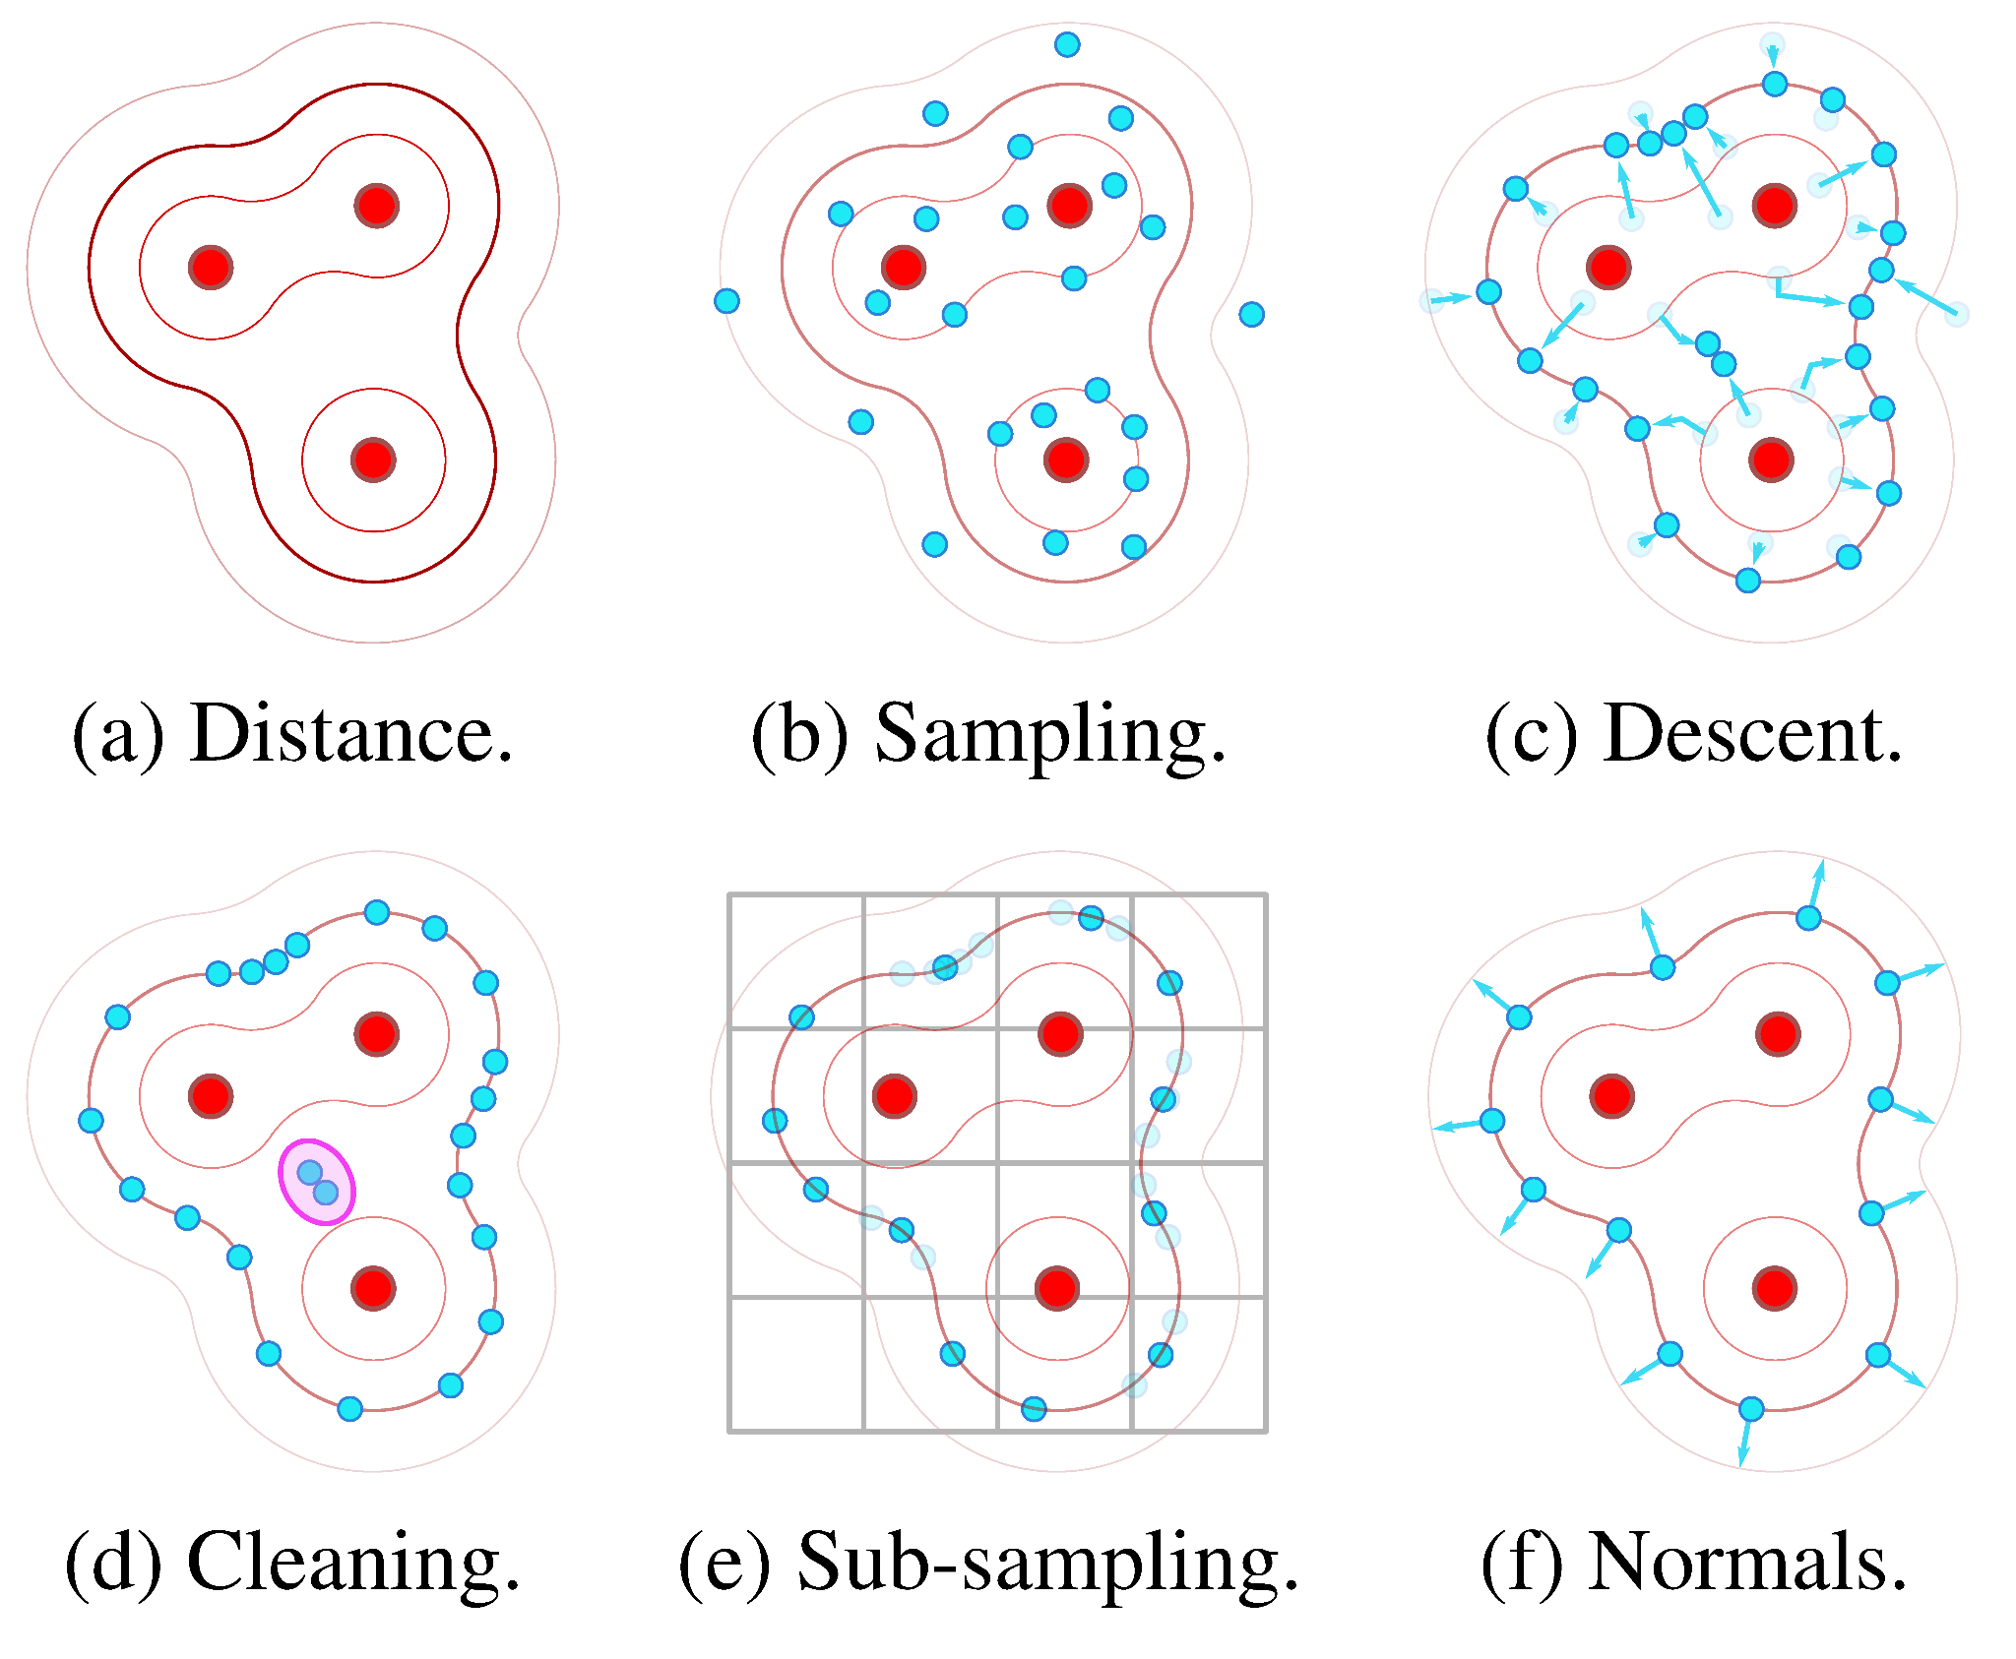
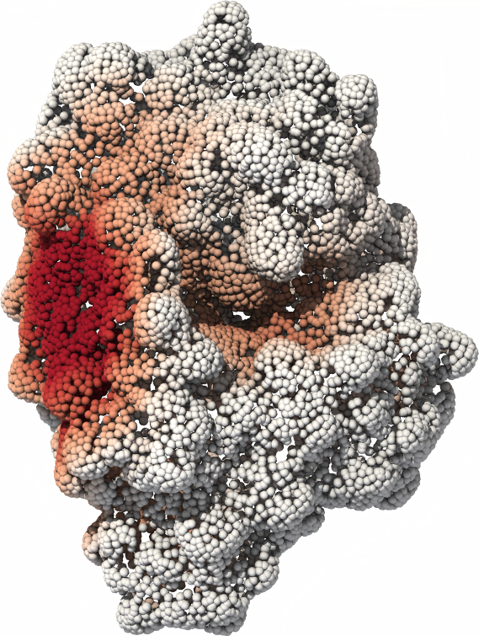
On-the-fly surface generation from raw atom coordinates
Protein surface,
sampled with 5k-20k points.
Notes:
Our approach relies on two fundamental contributions.
First, we introduce a fast sampling layer for protein surfaces.
Starting from the raw xyz coordinates of the atoms that make up a protein, we use a fast metaball method to sample protein surfaces with 5 to 20 thousand points.

Slide 10
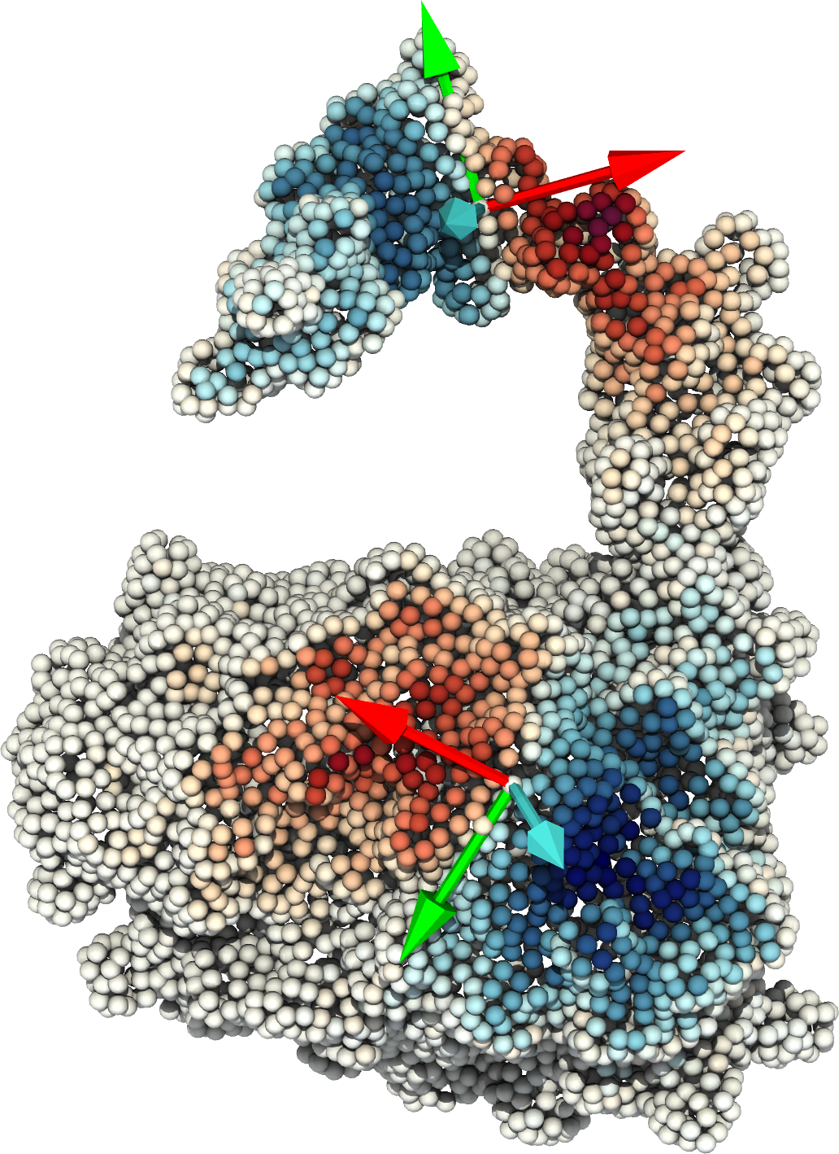
Quasi-geodesic convolution layer
Approximating the geodesic distance
with oriented point clouds.
Quasi-geodesic
convolution filters.
Notes:
Second, we rely on a simple approximation of the geodesic distance to define efficient convolution layers on oriented point clouds.

Slide 11
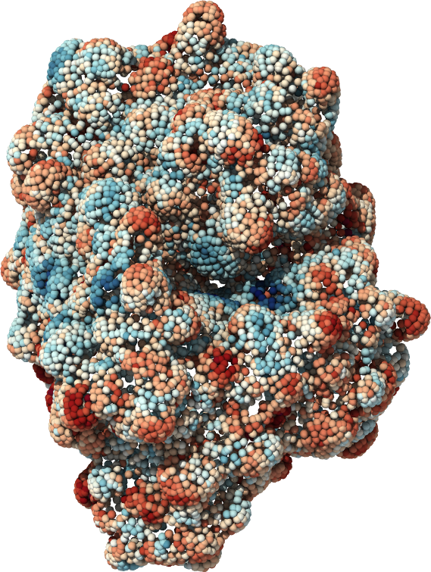
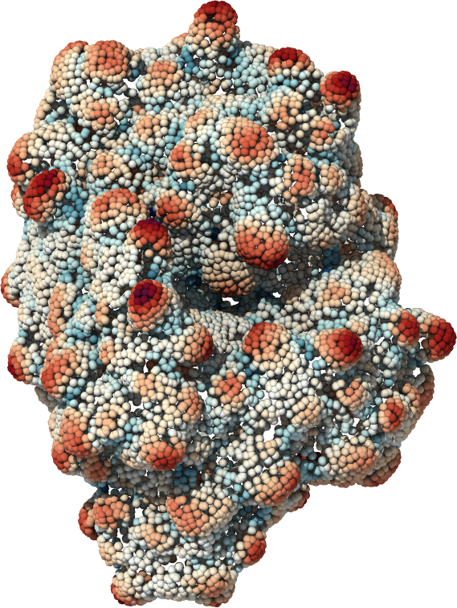
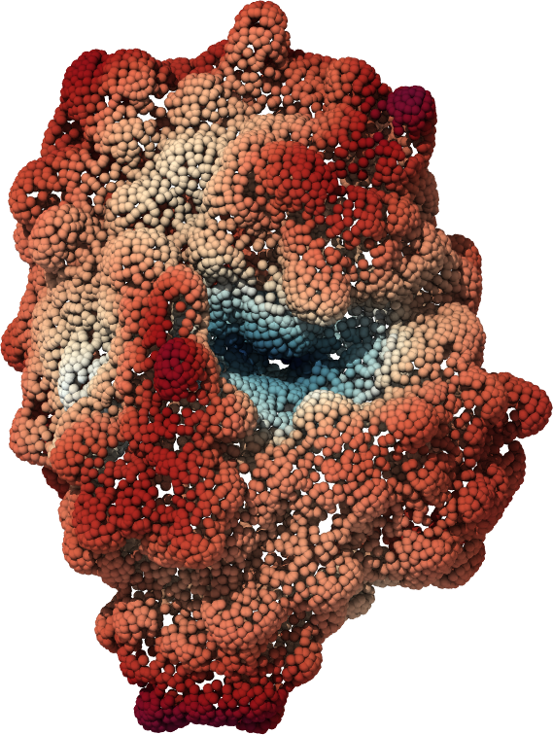
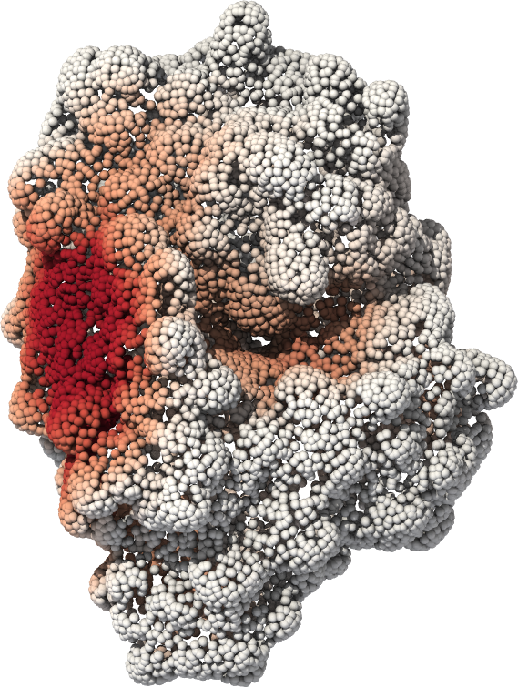
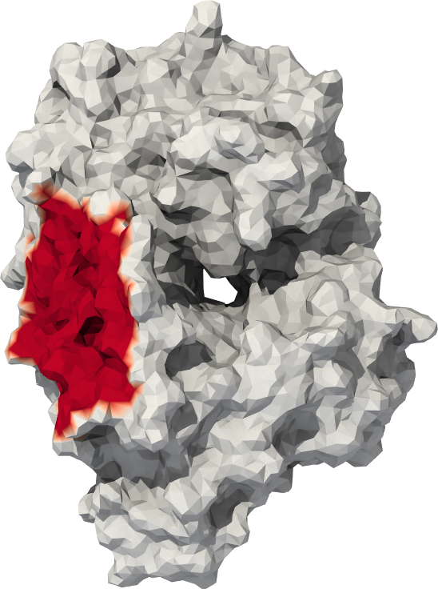
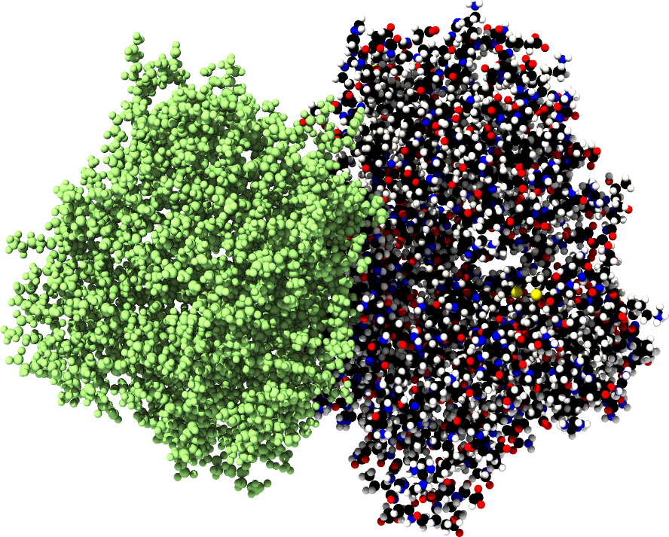
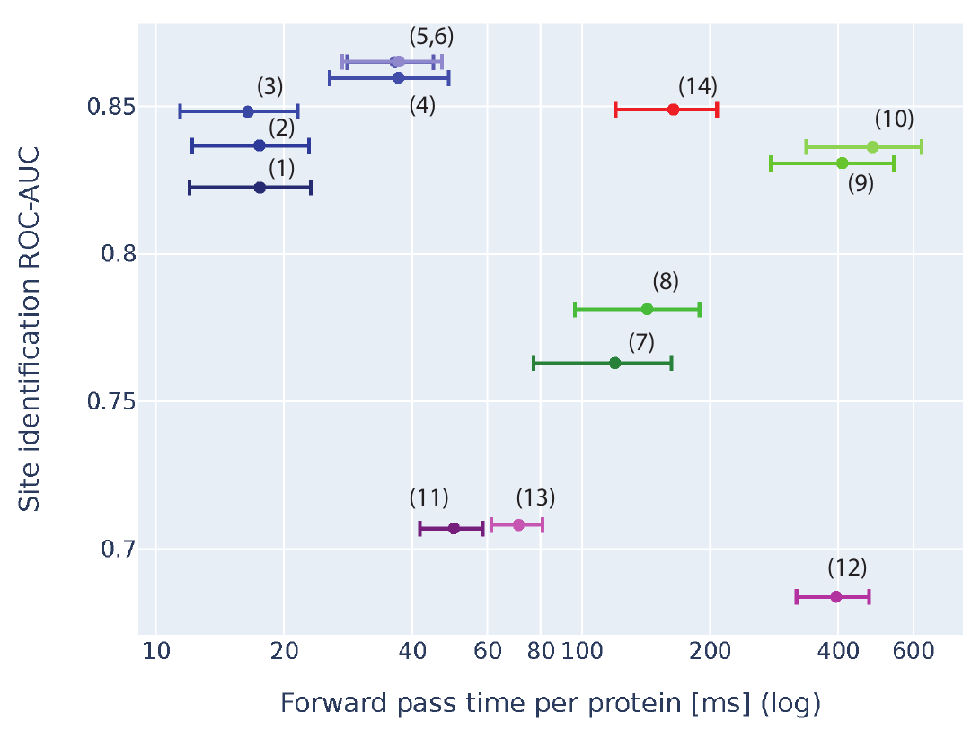
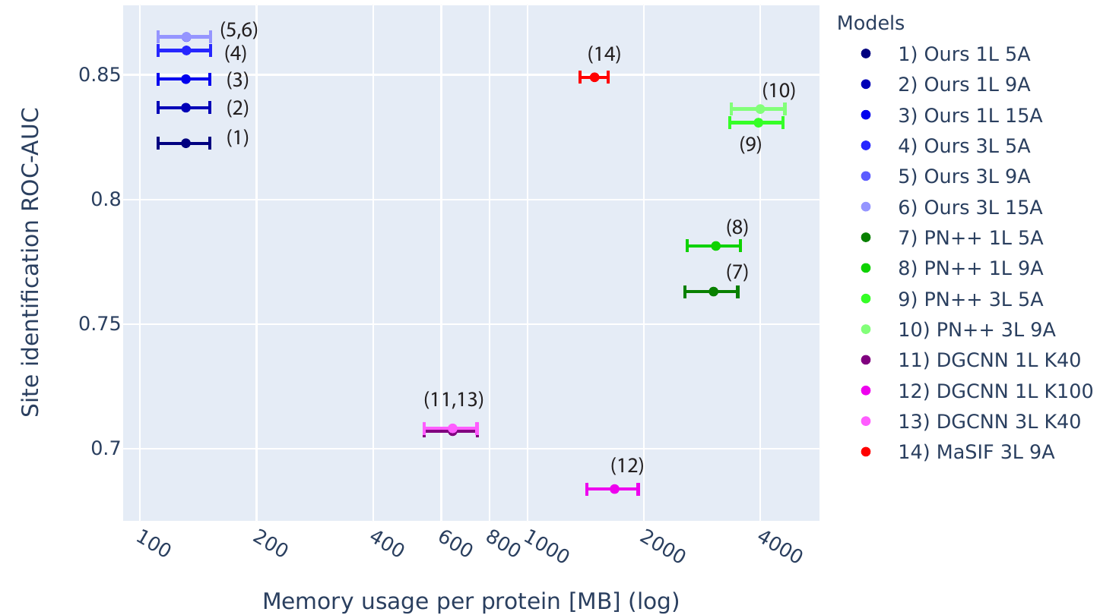
State-of-the-art performance with a significant speed-up
≈
Chemical and geometric input features,
computed from the raw atom point clouds.
Prediction.
Ground truth interface and protein docking.
Compared with mesh neural nets,
PointNet++ and DGCNN:
- No pre-processing.
- x10 speed-up.
- x10 more memory-efficient.
- SOTA accuracy.
Notes:
We combine these two components within an end-to-end convolutional architecture to solve the protein fingerprinting problem.
We achieve state-of-the-art results with a model that is lightweight, fully differentiable and orders of magnitude faster than pre-existing approaches.
This work is opening the door to de novo protein design with geometric deep learning.
Going further, we believe that it will be of interest to the wider CVPR community as an example of a point net architecture that is both scalable and tailored to the needs of a fundamental application in biology.

