Slide 1
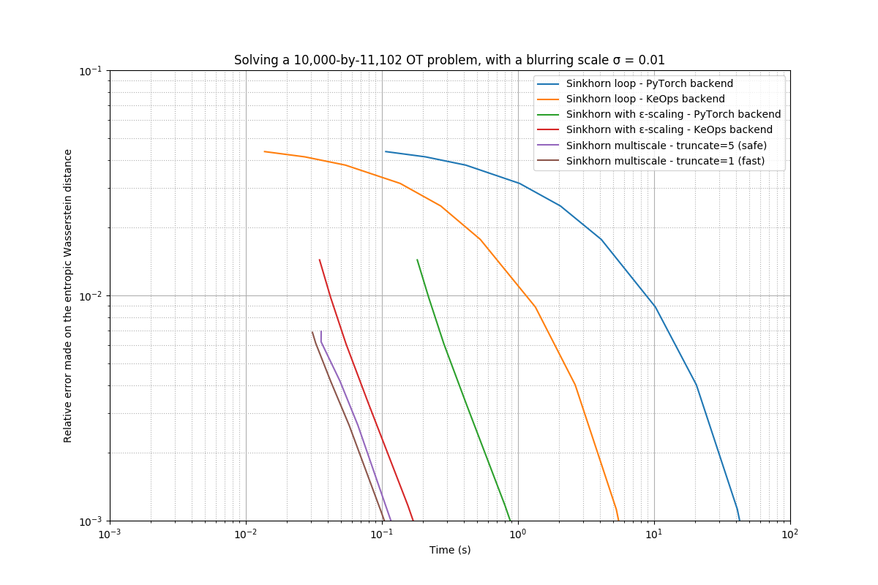
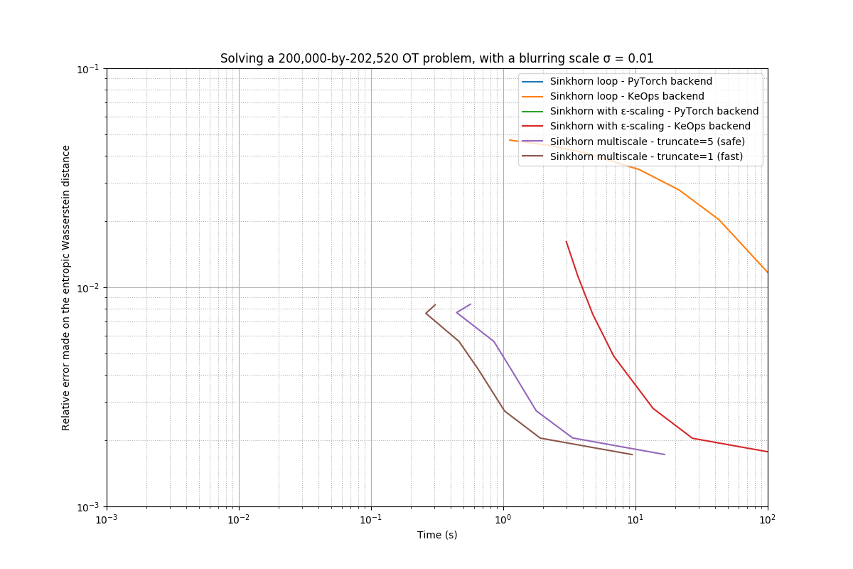
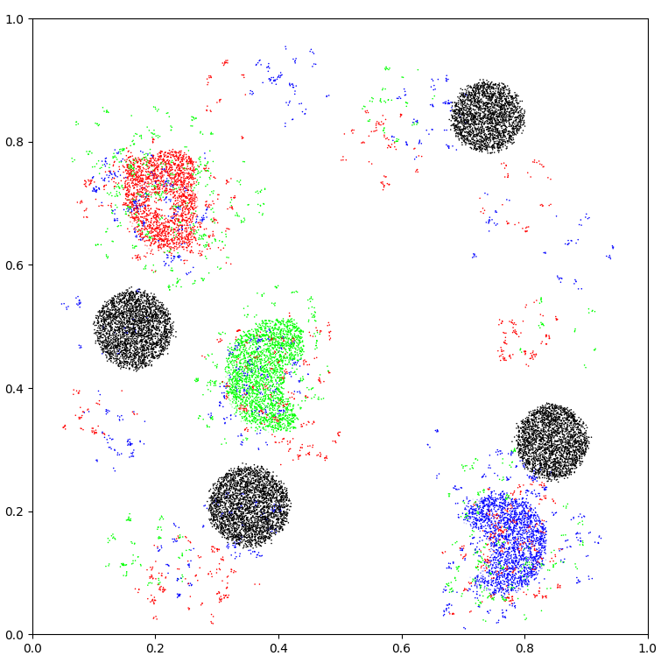
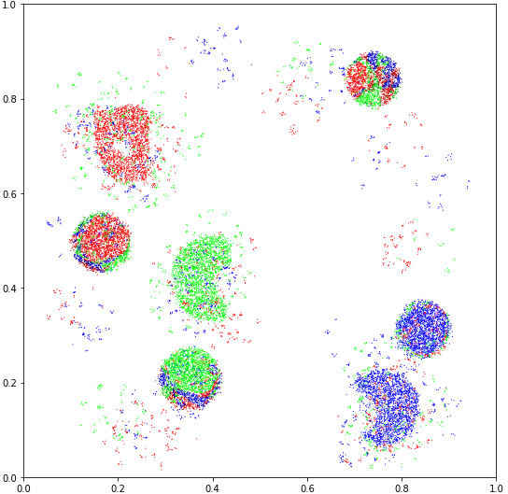
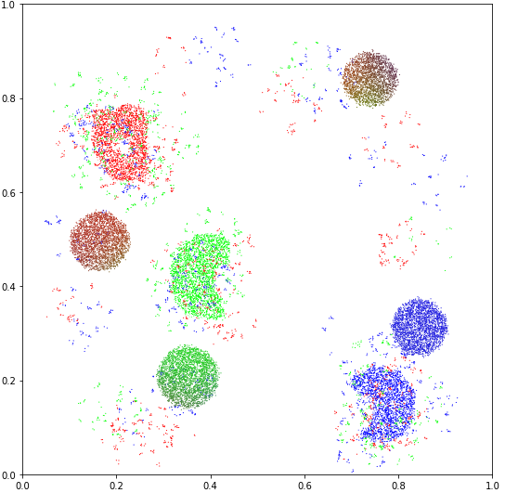
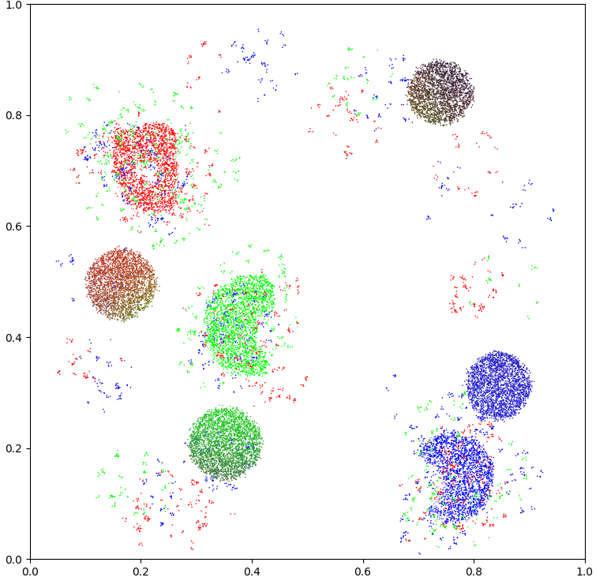
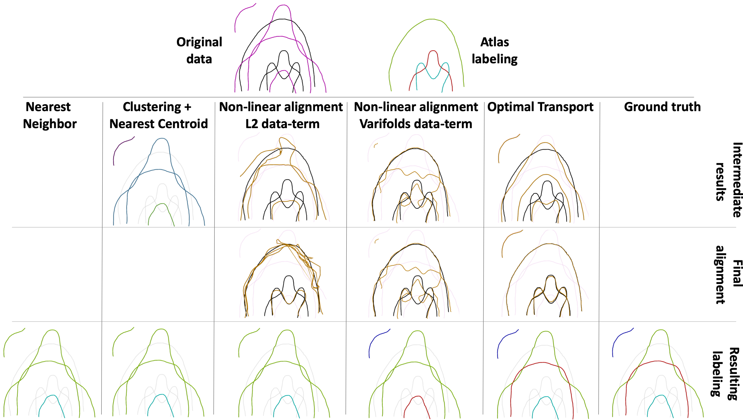
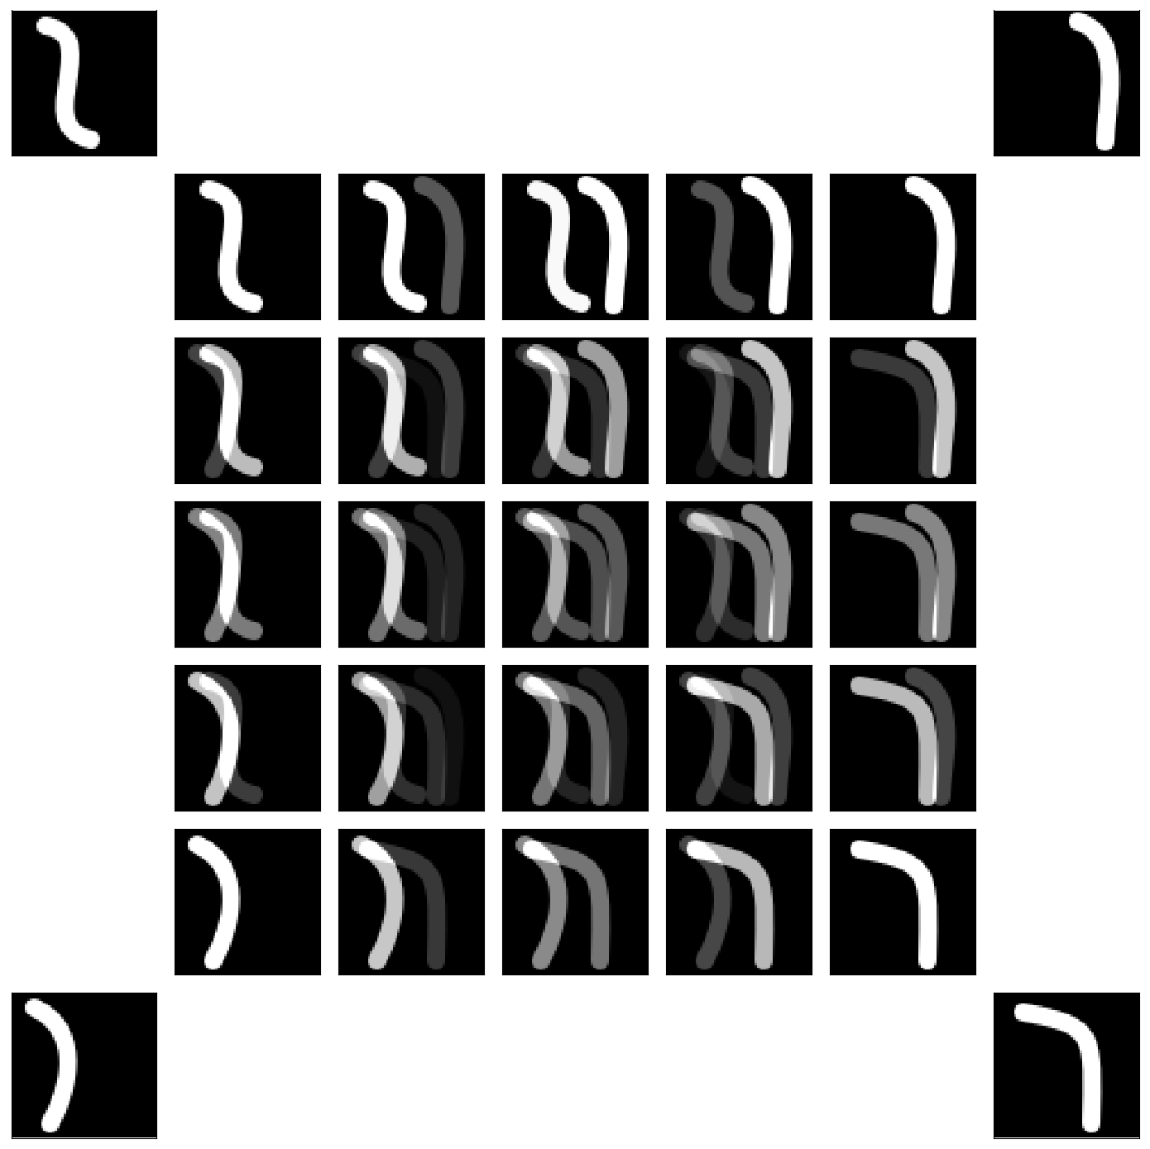
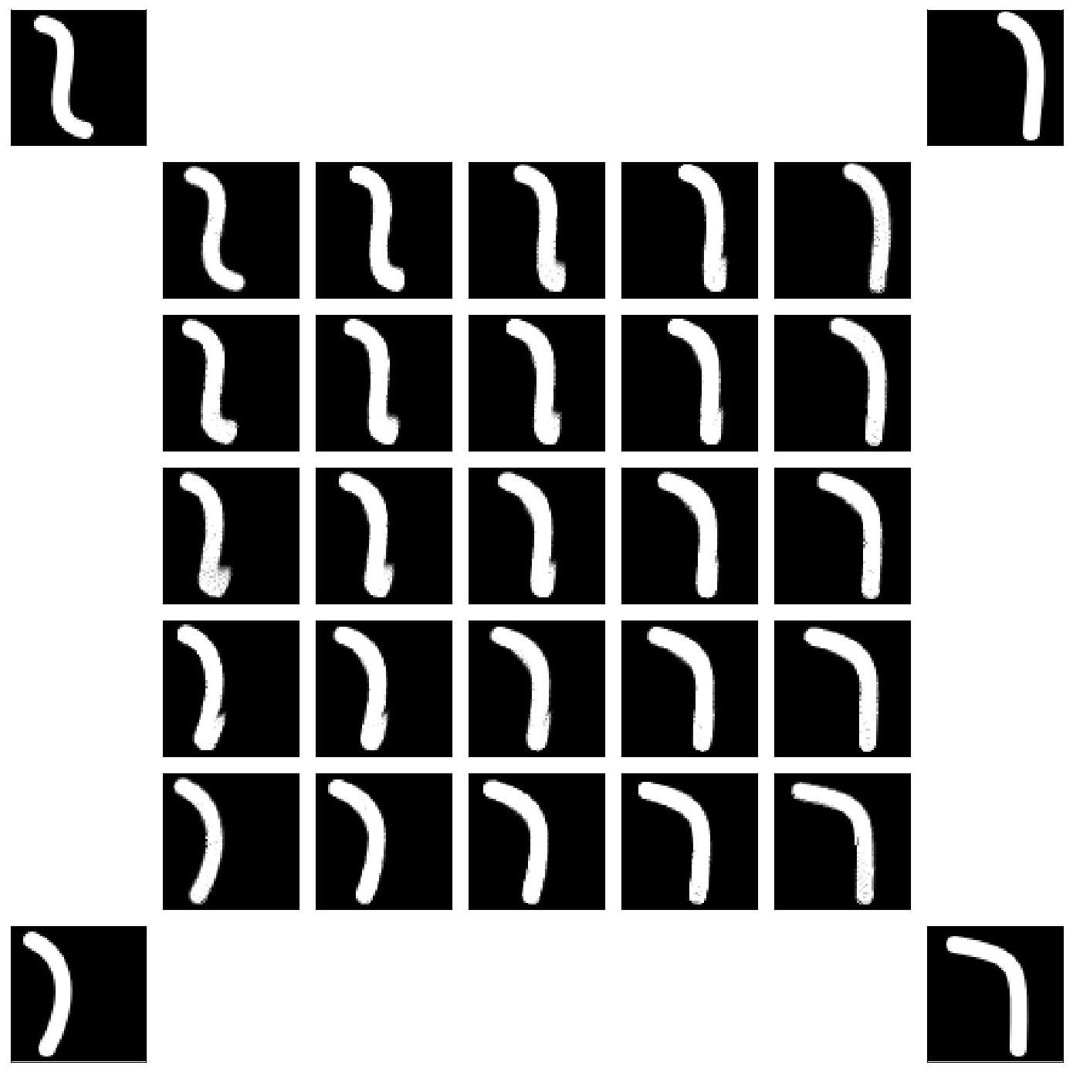
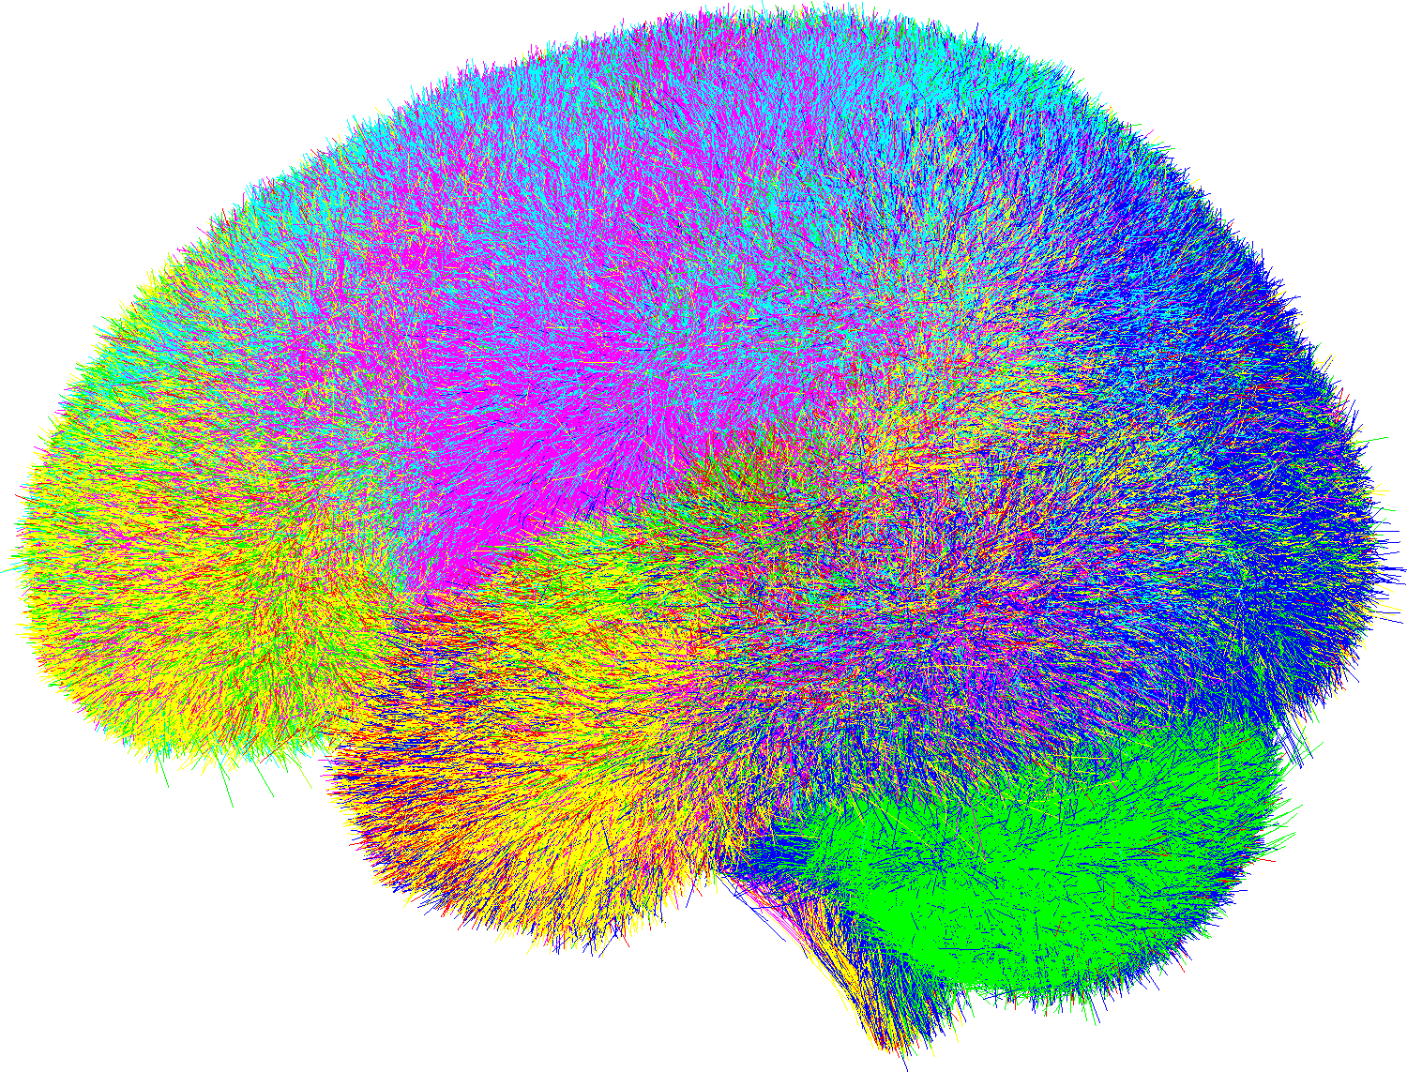
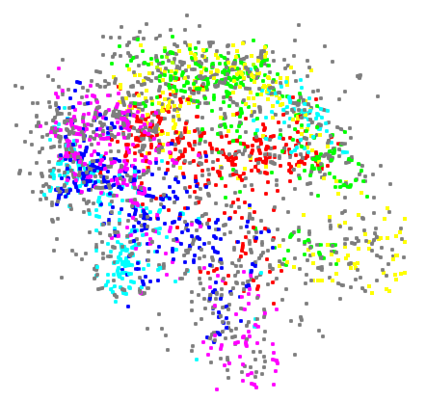
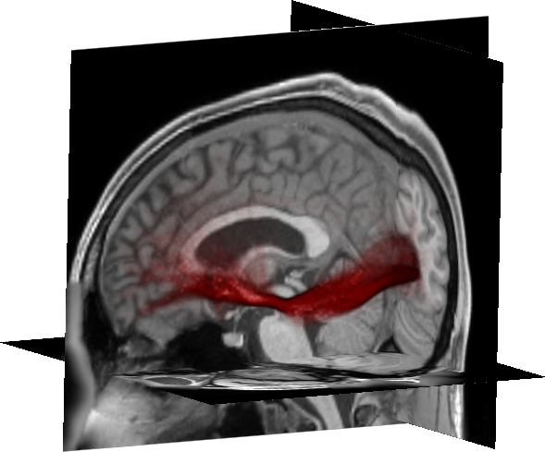
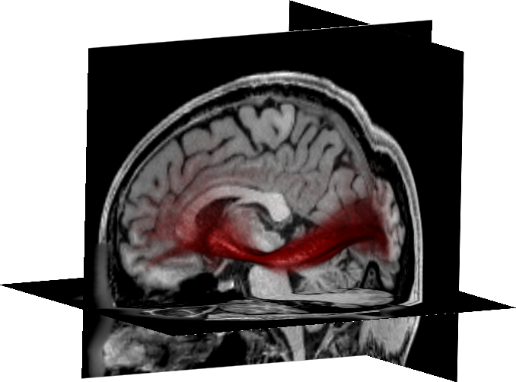
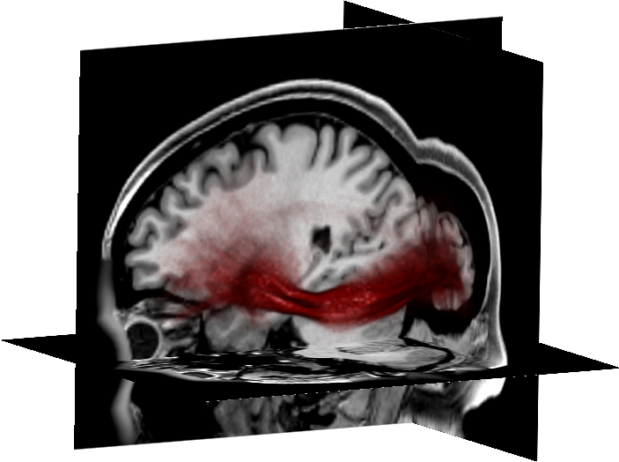
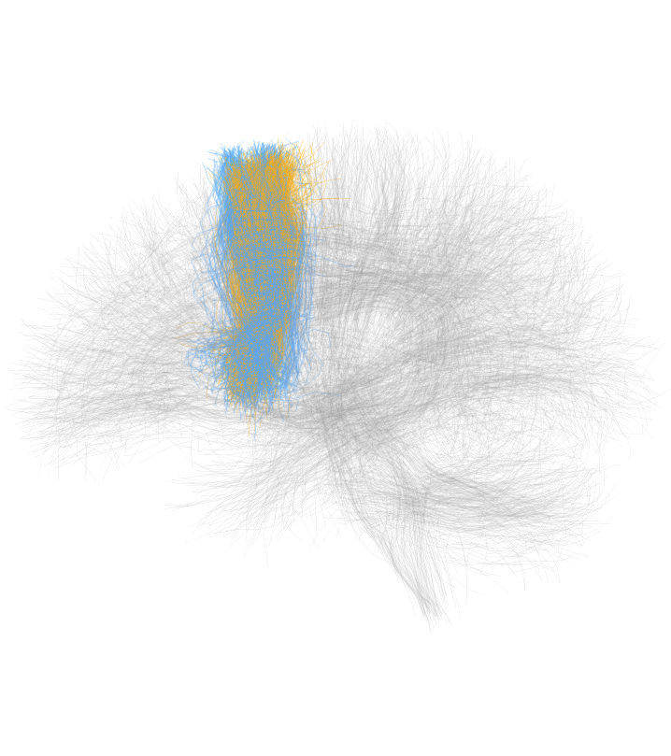
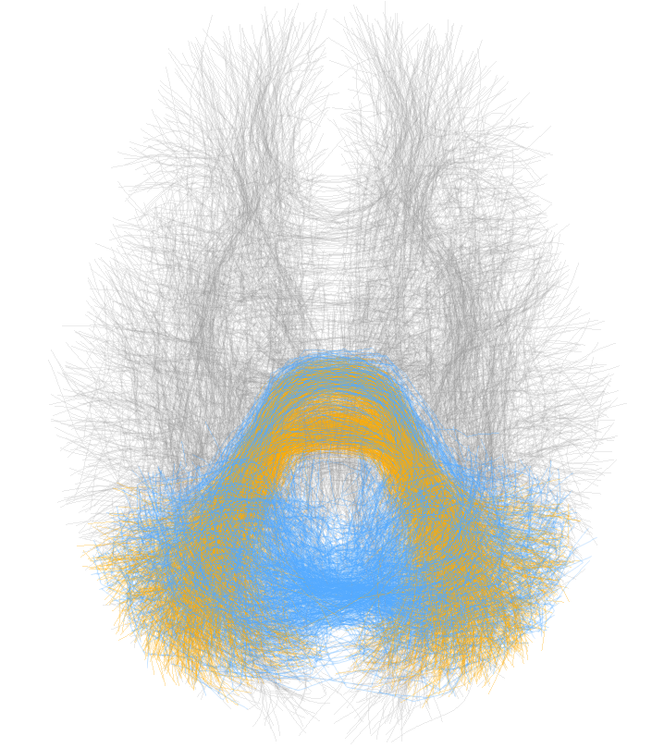
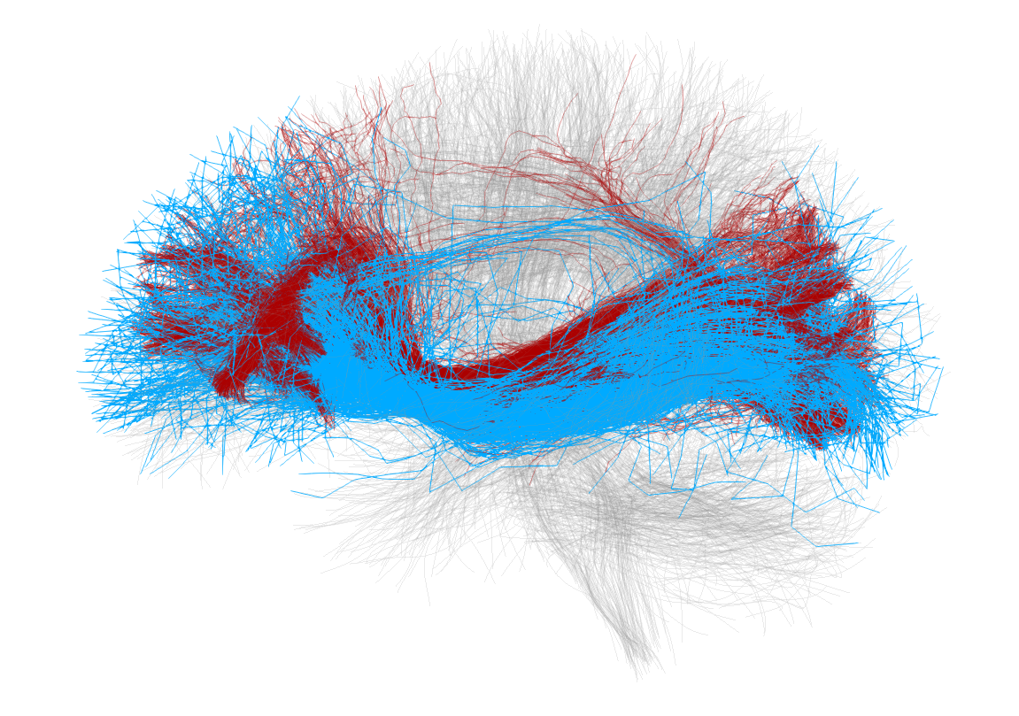
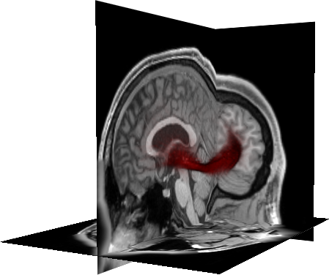
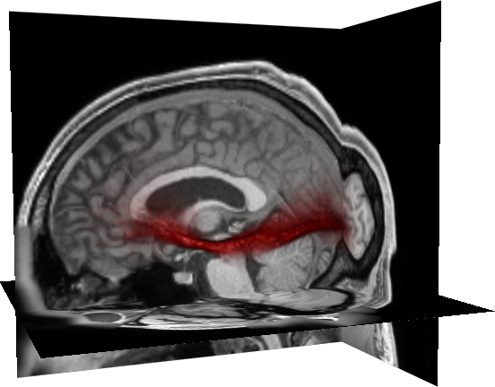
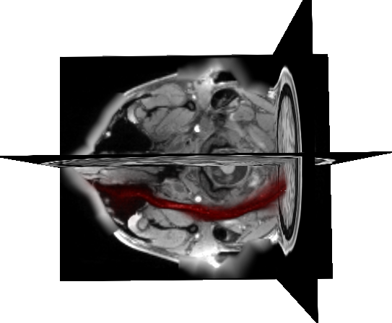
Fast and Scalable Optimal Transport for Brain Tractograms
Jean Feydy^{1,2*}, Pierre Roussillon^{3*}, Alain Trouvé¹ and Pietro Gori³
¹ CMLA, ENS Paris-Saclay, France
²DMA, École Normale Supérieure , Paris, France
³LTCI, Télécom Paris, Institut Polytechnique de Paris, France
R​obust and Regularized Optimal Transport
Our Contribution
Let $χ$ be a feature space, $α=\sum_{i=1}^{N}{α_{i}δ_{x_{i}}, β=\sum_{j=1}^{M}{β_{j}δ_{y_{j}} }}$ two weighted point clouds on $χ. T$he robust and regularized optimal transport problem reads:
Multiscale algorithm for solving the regularized OT problem
→ x10-1,000 speed-up compared with the baseline Sinkhorn algorithm [2].
GPU implementation with a linear footprint memory (KeOps library)
→ We scale up to millions of points.
User-friendly PyTorch interface available
pip install geomloss and www.kernel-operations.io/geomloss.
Applications to barycenter estimations on track density maps,
and segmentation transfer on brain tractograms.
$$OT_{ε,ρ}(α,β)= Transport cost + ε . Regularization + ρ . Relaxation$$
$$=\min_{π∈ℝ_{≥0}^{N×M}}\left\langle π, C\right\rangle +εKL\left(π,α⊗β\right)$$
$$+ρKL\left(π1,α\right)+ρKL(π^{T}1,β)$$
3 hyperparameters : $ε, ρ$ and the cost $C$ matrix (usually $C\left(x,y\right)=\frac{1}{2}{\left|x−y\right|}^{2}$)
OT for Label Transfer
If the target distribution $β$ is labelled with L classes, the transport plan $\left(π_{i,j}\right)$ can be used as a soft-assignement to transfert the labels on $α:$
$$Lab_{i}=1/α_{i}\sum_{j=1}^{M}{{π_{i,j}l}_{j}}$$
one-hot vector of labels in $ℝ^{L}$
Fig: Relative error on the entropic OT with respect to computational time, for different backends (PyTorch or Keops) and different strategies.
Toy data-set of 2D points. Atlas has three coloured labels. Target is in black.
Classical OT:
optimal assignment between the point clouds, generalizes sorting [3]
Regularized OT:
"Blurs" the transport problem and improve robustness [2]
Regularized, unbalanced OT:
Introduces a maximum "reach" to discard outliers. [1,4]
Label Transfer on Brain Tractograms
Wasserstein Barycenter
By minimizing${\frac{1}{K}\sum_{k=1}^{M}{OT_{ε,ρ}\left(α,β_{k}\right)}}$ with respect to the position $x_{i}$ of $α$, where $α$ is the atlas, we estimate the Wasserstein barycenter of the $β_{k}$. Here $α$ and $β_{k}$ are images and so ${ β}_{k}= \sum_{j=1}^{M}{β_{j,k}δ_{y_{j,k}}}$ where $β_{j,k}$ are intensities and $δ_{y_{j,k}}$ the voxel positions.
Fig: Label transfer between an atlas (black) and a subject (magenta) using different strategies.
In the last row fibers detected as outliers are shown in dark blue.
Fig: Linear (left) vs Wasserstein (right) interpolations between 4 images (corners). The OT interpolation is a cheap way of computing a geometric barycenter.
Application on Track Density Maps
Each fiber is sampled with 20 points and seen as a point in $ℝ^{60}$
Barycenter of 5 track density maps of the left IFOF computed with MrTrix. Left IFOF were manually segmented. Track density maps are 3D probability distributions
$⟹$ OT is a natural tool to study these data.
Unlabelled tractogram
of 1M fibers
$$ℝ^{60}$$
Labelled atlas of 800k fibers and 800 clusters (from [4])
fiber $i$ in $ℝ^{60}$
fiber $j$ with label$lab_{j}$
…
…
$$α=\frac{1}{N} \sum_{i=1}^{N}{δ_{x_{i}} }$$
$π^{∗}=\arg{\min{{OT}_{ε,ρ}(α, β)} }$
Computed on the whole tractogram in 30 minutes
$$β=\frac{1}{M}\sum_{j=1}^{M}{δ_{y_{j }}}$$
Subject 1
Subject k
Subject K
Estimated Wasserstein barycenter
Fig: Some clusters of the atlas (in orange) with their respective segmentations (in light blue) of one random subject. On the right: comparison of a manual segmentation (in red) vs the segmentation obained with our method (light blue).
[1] Chizat, L. et. al. « An interpolating distance between optimal transport and Fisher-Rao metrics. Foundations of Computational Mathematics 2018. [2] Cuturi, M « Sinkhorn distances : Lightspeed computation of optimal transport ». NIPS 2013. [3] Kantorovich, L. « On the transfer of masses », 1942. [4] Peyré, G. and Cuturi, M. « Computational optimal transport. » Foundatios and Trends in Machine Learning 2019. [5] Zhang, F. et. al. « An anatomically currated fiber clustering white matter atlas for consistent white matter tract parcellation across lifespan. NeuroImage 2018. Data are from the HCP project : https://db.humanconnectome.org.

